Slide 1
Comments are Welcome
Online feedback systems are open (Due soon)
https://venus2.wis.ntu.edu.sg/SFT/Login.aspx
Your comments are VERY important:
To have a self-assessment process
To improve teaching and course content/structure
Speak out:
If you think of any improvements that you can suggest, that would be great feedback as well
If you like my lecture, I will treasure the good teaching experience
Notes:
Thank you and good luck.

Slide 2

Synchronization Concept
Keep Wooclap open on your device before the lecture ends

Slide 3
Synchronization Concepts
Keep Wooclap open on your device before the lecture ends

Slide 4
Course Overview
OS goals
CPU management
Memory management
Filesystem management
Processes (L2)
Scheduling (L3)
Memory organization (L8)
Virtual memory (L9-10)
Filesystems (L11)
Synchronization (L4-5)
Deadlocks (L6)
I/O & disk (L12)
Special: Real-time OS & virtualization (L7)

Slide 5
Part 5: Deadlocks and Starvation
Deadlock Problem
System Model
Deadlock Conditions
Deadlock Prevention
Deadlock Avoidance
Deadlock Detection – not examinable
Notes:
This is the outline of deadlock and starvation. We first define what is a deadlock; We will show how to model the deadlock problem in a systematic way. We will then see the conditions for deadlock, and the methods to handle the deadlock. We have prevention; avoidance and detection. Due to the time constraint, we cannot cover all the details about deadlock detection. So, deadlock detection is not examinable.

Slide 6
The Deadlock Problem
Deadlock: A set of blocked processes each holding a resource and waiting to acquire a resource held by another process in the set
Example 1:
System has two different types of tape drives; both P1 and P2 need the two tapes to finish execution
P₁ and P₂ each hold one tape drive and need the other
Example 2: Semaphores A and B, initialized to 1
P₀ P₁
wait (A); wait (B);
wait (B); wait (A );
Context switch points
Notes:
We have already seen deadlocks in the previous chapter. A set of blocked processes each holding a resource and waiting to acquire a resource held by another process in the set.
Another example is incorrect usage of semaphores. Say, we have two semaphores A and B initialized to 1. The two processes P0 and P1 can deadlock. We have seen this example in the previous chapter.

Slide 7
Bridge Crossing Example
Deadlock
Only one car is allowed on the bridge
The bridge can be viewed as a shared resource
If a deadlock occurs, it can be resolved if one car backs up (release resource, i.e., the bridge, and rollback)
Several cars may have to be backed up if a deadlock occurs
Notes:
The bridge is a resource and the cars are processes.
Deadlock occurs if there are two cars on the bridge. When deadlock occurs, it can be resolved if one car backs up. Note, several cars may have to be backed up if a deadlock occurs. That means, deadlock recovery may affect other processes. Not only the process in the deadlock state are affected, but also other processes that have dependency on the deadlocked process.

Slide 8
Part 5: Deadlocks and Starvation
Deadlock Problem
System Model
Deadlock Conditions
Deadlock Prevention
Deadlock Avoidance
Deadlock Detection

Slide 9
System Model
Resource types R₁, R₂, . . ., R_{m}
Memory space, I/O devices, semaphores, etc.
Each resource type R_{i} has W_{i} identical instances
Each process utilizes a resource as follows:
Request for a specific number of instances
Use
Release all the instances
Notes:
We now introduce the system model for deadlock. In this model, we have different resource types R1… Rm. The resource type can be memory space or I/O devices. Each resource type Ri has Wi identical instances. For example, we have two hard disks in the system. Ri is the hard disk and Wi=2. the instances are all identical.
A process utilizes a resource as follows: first sends a request of a certain number of instances.
If the instances are available, then the request is granted. Otherwise, the process needs to wait. If the request is granted, the process uses the resource, and after sometime, releases the resource.

Slide 10
Resource-Allocation Graph
Graph → A set of vertices V and a set of edges E
V is partitioned into two types
P = {P₁, P₂, …, P_{n}}, the set consisting of all the processes in the system
R = {R₁, R₂, …, R_{m}}, the set consisting of all resource types in the system
E is partitioned into two types
Request Edge: Directed edge P_{i} → R_{j}
When the request is granted, this edge is removed
Assignment Edge: Directed edge R_{j} → P_{i}
When the resource is released, this edge is removed
Notes:
Consider the system has multiple processes and multiple resource types. How to model resource request, use and release?
We use a data structure called the resource-allocation graph to model the resource allocations in the system. The graph has a set of vertices V and a set of edges E. V is partitioned into two types: process vertex and resource type vertex. The process vertices represent all the processes, and resource vertices represent all the resource types in the system.
When a process sends a request for Rj, we add a directed edge from Pi to Rj. When the request is granted, the request edge is removed. Then, we add an assignment edge between the two vertices in the reverse direction. When the resource is released, the assignment edge is removed.

Slide 11
Resource-Allocation Graph (Cont.)
Process
Resource Type with 4 instances
P_{i} requests instance of R_{j}
P_{i} is holding an instance of R_{j}
P_{i}
R_{j}
P_{i}
R_{j}
Notes:
The number of solid black dots within the rectangle represents the number of instances for the resource.
When an instance of Rj is assigned to Pi, we draw an edge from one dot within the rectangle to Pi. Assignment of an instance of resources to the process: a certain dot within the resource vertex to the process vertex.

Slide 12
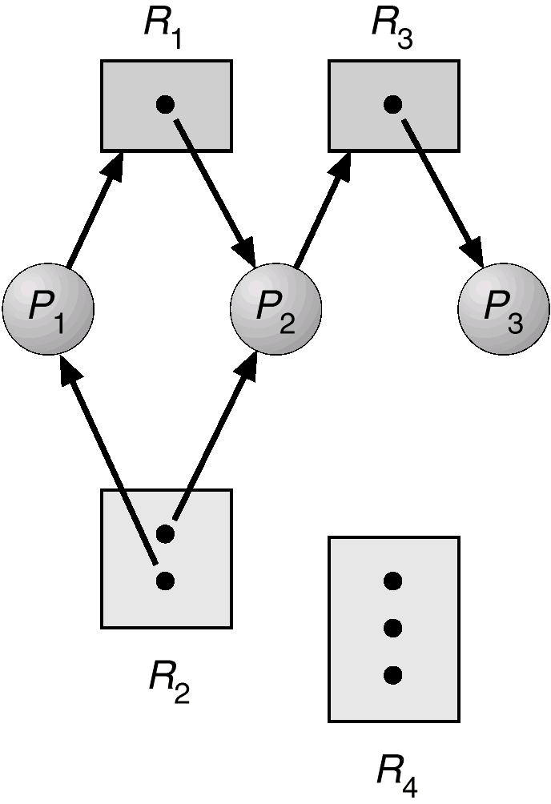
Example of a Resource Allocation Graph
Is there a deadlock?
No deadlock
Can you identify a sequence of process executions so that all requests are met?
P3->P2->P1
Notes:
We have four resource types. Three processes.
We can actually examine the structure of the resource allocation graph to see whether the system has deadlock or not. Ideally, if the system has deadlock, the resource allocation must have a cycle. why? By the definition of deadlock ☺
In this case there is no deadlock. Can you find a sequence of process execution that all the processes finish execution? If P3 finishes, P2 can finish, and then P1 can finish.

Slide 13
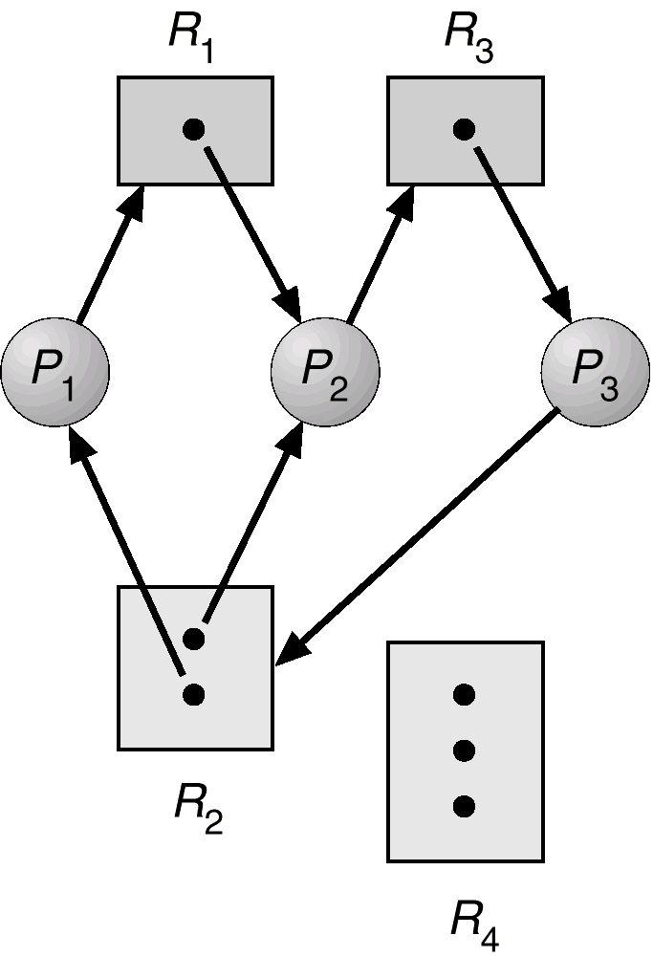
Resource Allocation Graph With A Deadlock
Does this mean a cycle in the graph always indicates a deadlock?
Notes:
How many cycles are there in this resource allocation graph?
Two cycles. First cycle: P2 waits for P3 and P3 waits for P2. Second cycle: P1 waits for P2, P2 waits for P3, and P3 waits for both P1 and P2. In this case, no process can make any progress. →Deadlock.

Slide 14
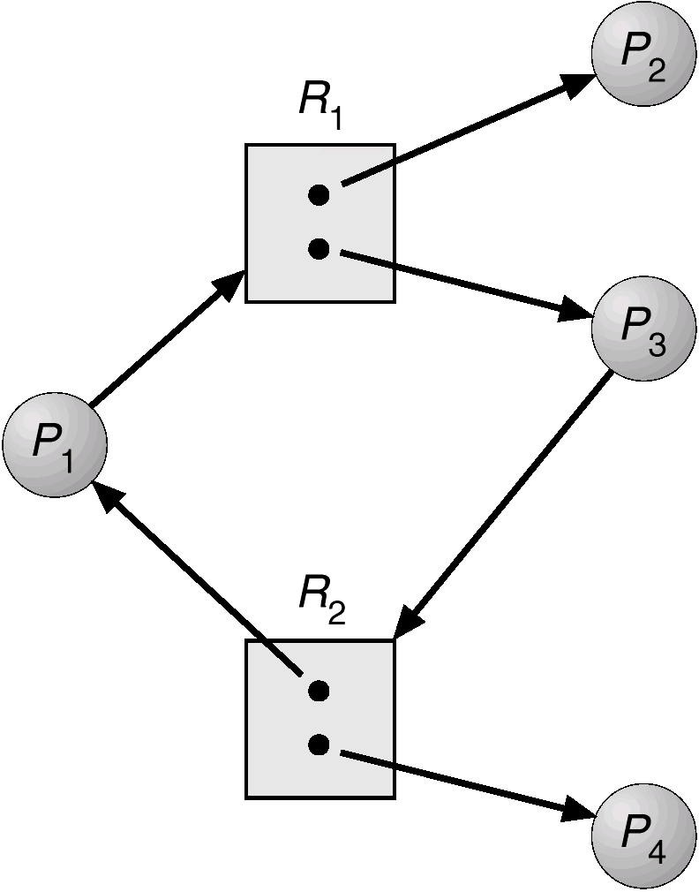
Resource Allocation Graph With A Cycle But No Deadlock
Process execution order that avoids a deadlock
P2->P4->P3->P1
Notes:
One cycle. But no deadlock. Because P2 can finish and release R1. Then P4 can finish. Then, P3 and P1 can finish.

Slide 15
Basic Facts
If graph contains no cycles ⇒ no deadlock
If graph contains a cycle ⇒
If only one instance per resource type, then deadlock
If several instances per resource type, possibility of deadlock
Notes:
So, in summary, if a graph contains no cycle, no deadlock for sure. Because we do not have the problem of A waiting for B and B waiting for A.
If the graph contains a cycle, we need to look at the resource types. If only one instance per resource type, then there is a deadlock. Because no process can make any progress. If several instances per resource type, deadlock is possible, but not 100% sure.
We will introduce banker’s algorithm to solve the problem with multiple instances later on.

Slide 16
Part 5: Deadlocks and Starvation
Deadlock Problem
System Model
Deadlock Conditions
Deadlock Prevention
Deadlock Avoidance
Deadlock Detection

Slide 17
Deadlock Conditions
Deadlock may arise if the following four conditions hold simultaneously
(necessary, but not sufficient)
Mutual exclusion: Only one process at a time can use a resource instance
Hold and wait: A process holding at least one resource is waiting to acquire additional resources held by other processes
Notes:
When there are multiple instances per resource type, we are not sure whether the graph has deadlock even if the graph has cycles. To handle this case, we study the deadlock conditions, that is, conditions necessary for a deadlock to occur. Deadlock can arise if the four conditions hold simultaneously. If any of them is violated, there is no deadlock. Also, the four conditions are necessary, but not sufficient.
We will briefly talk about the definitions here, and then give more examples in the later slides.

Slide 18
Deadlock Conditions (Cont.)
No preemption: A resource can be released only voluntarily by the process holding it, after that process has completed its task
Circular wait: There exists a set {P₀, P₁, …, P_{n}} of waiting processes such that P₀ is waiting for a resource that is held by P₁, P₁ is waiting for P₂, …, P_{n–1} is waiting for P_{n}, and P_{n} is waiting for P₀
Notes:
No preemption means we cannot take the resource from the process by force. Circular wait corresponds to a cycle in the resource allocation graph.

Slide 19
Deadlock Conditions

Slide 20
Part 5: Deadlocks and Starvation
Deadlock Problem
System Model
Deadlock Conditions
Deadlock Prevention
Deadlock Avoidance
Deadlock Detection

Slide 21

Methods for Handling Deadlocks
Ensure that the system will never enter a deadlock state
Allow the system to enter a deadlock state and then recover
Ignore the problem and pretend that deadlocks never occur in the system
Used by most operating systems, including UNIX
Notes:
There are multiple approaches to handling deadlocks.
First, we can ensure that the system will never enter a deadlock state. That is deadlock prevention and avoidance.
Second, we can allow the system to enter a deadlock state and then recover. That is deadlock detection.
Third, we simply ignore the problem and pretend that deadlocks never occur in the system. That means, do nothing. That is so called Ostrich approach. Why do most systems use Ostrich approach? Efficiency. The overhead of deadlock detection and prevention is high. Why do we learn about deadlock detection and prevention then? Because OS doesn’t implement deadlock, it is the user’s responsibility to handle deadlock in their programs. So, we need to pay attention to deadlock issues when we develop our multi-programmed software.

Slide 22
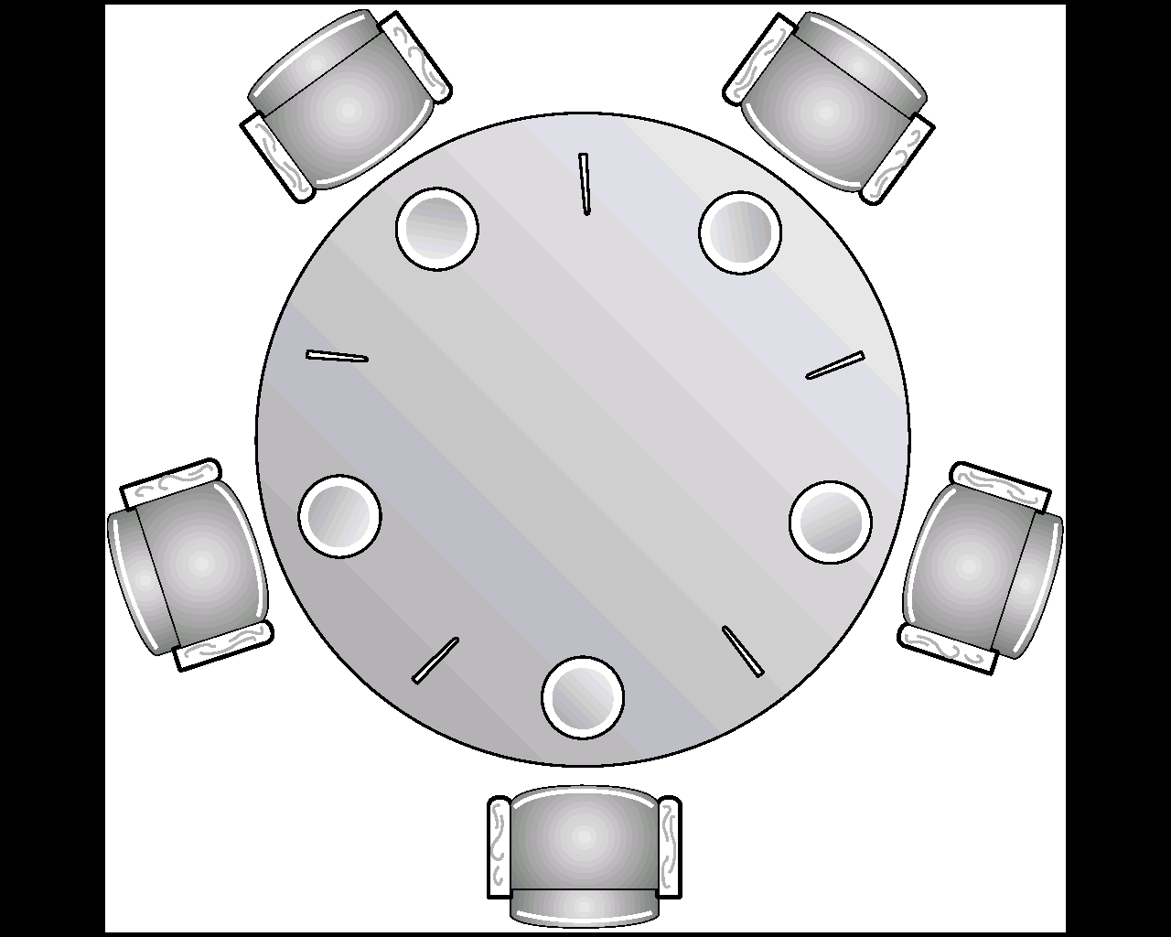
Deadlock Prevention
Prevent at least one of the four deadlock conditions We will illustrate using Dining-Philosophers Problem
Recall dining-philosopher solution using semaphores
Each chopstick is a shared resource protected by a binary semaphore (chopstick [ 5 ];)
Initially, for all i, chopstick [ i ] = 1;
Code (Process Philosopher i)
while (1) {
wait(chopstick [ i ]);
wait(chopstick [ (i+1)%5 ]);
eat
signal(chopstick [ i ]);
signal(chopstick [ (i+1)%5 ]);
think
}
Notes:
For philosopher i ( 0<=i<5): He first picks up his left chopstick, and then the right chopstick. This is done by calling the wait operation on the corresponding semaphore. If both operations can succeed, the philosopher can eat. After eating, he releases the left chopstick and then the right one. After that, the philosopher will think, and then repeat the process.
Does this solution have any problem? Each philosopher executes the first line and a context switch occurs. → deadlock.

Slide 23
Deadlock Prevention (Cont.)
Prevent at least one of the four deadlock conditions We will illustrate using Dining-Philosophers Problem
Mutual Exclusion
Chopsticks are not shareable (simultaneously), hence this condition cannot be eliminated
Hold and Wait: Must guarantee that whenever a process requests a resource, it does not hold any other resource
Allow a philosopher to pick up chopsticks only if both the required chopsticks are available
Notes:
We will talk about how to prevent the deadlock conditions one by one. Recall, the four conditions are necessary to hold simultaneously for a deadlock to occur. So, we can prevent any one of them to happen. We illustrate that with Dining-Philosophers as an example.
Hold and wait: In Dining-Philosophers, allow a philosopher to pick up his chopsticks only if both the chopsticks are available. That means, at the beginning, the philosopher hasn’t taken any chopstick. In that case, there is no hold and wait. So, no deadlock.

Slide 24
Deadlock Prevention (Cont.)
Prevent at least one of the four deadlock conditions We will illustrate using Dining-Philosophers Problem
No Preemption
If a philosopher cannot get the second chopstick, then preempt and release the chopstick that is being held
Circular Wait
Allow at most four philosophers to be hungry simultaneously
Odd-Even solution (see previous lecture)
Chopsticks can only be acquired in order (next slide)
Notes:
No preemption. To prevent this condition, we need to allow preemption. That is, If a process that is holding some resources requests another resource that cannot be immediately allocated to it, then all resources currently being held are released. The process restarts later. In Dining-Philosophers, if a philosopher cannot get another chopstick for a long time, preempt. That means, the philosopher needs to put down the chopstick, and then restarts.
Circular wait: In Dining-Philosophers, allow at most four philosophers to be hungry simultaneously. This is because of pigeon hole theory.

Slide 25
Chopstick Ordering to Prevent Circular Wait
B
C
2
1
3
D
A
0
4
1st request
2nd request
E
Notes:
In the dining philosopher problem, each chopstick has an ID. Suppose each philosopher takes the chopstick with the small id first, and then takes the chopstick with the large id.
First request in black.
Second request in yellow.
→ No circular wait.
→ No deadlock.

Slide 26
Part 5: Deadlocks and Starvation
Deadlock Problem
System Model
Deadlock Conditions
Deadlock Prevention
Deadlock Avoidance
Deadlock Detection

Slide 27
Deadlock Avoidance
The deadlock-avoidance algorithm dynamically examines the resource-allocation state to ensure that the system never goes into unsafe state
When a process requests an available resource, system must decide if immediate allocation leaves the system in a safe state
If safe, the request is granted, and otherwise, the process must wait
System is in safe state if there exists a safe completion sequence of all processes without deadlock
Notes:
The deadlock prevention breaks one of the deadlock conditions. We now consider a more general deadlock avoidance algorithm. The algorithm is run whenever a process requests resources. The algorithm examines the resource-allocation state, and ensures that the system never goes into unsafe state. That is, when a process requests an available resource, system must decide if immediate allocation leaves the system in a safe state. If safe, the request is granted. Otherwise, the process must wait.
So what is safe state? System is in safe state if there exists a safe sequence of all processes. We do not require all sequences are safe. Only one safe sequence is sufficient.

Slide 28
Deadlock Avoidance: Intuition
Assume many processes requesting access to shared resources
Question 1: Is there a safe sequence of acquiring and releasing the resources so there is no deadlock? If yes, then the state is safe
Question 2: Does Action X lead to a safe state? If yes, it is safe to take this action

Slide 29
Safe State
A process completion sequence <P₁, P₂, …, P_{n}> is safe, if for each P_{i}, the resources that P_{i} requests can be satisfied by currently available resources + resources held by all the P_{j}, j< i
If P_{i}’s needs cannot be immediately met, then P_{i} can wait until all P_{j}, j<i have finished
When all P_{j} (j<i) are finished, P_{i} can obtain needed resources, execute, return allocated resources, and terminate
When P_{i} terminates, P_{i+1} can obtain its resources, and so on
All processes in the sequence can finish
Notes:
Sequence <P₁, P₂, …, P_{n}> is safe if for each P_{i}, the resources that P_{i} requests can be satisfied by currently available resources + resources held by all the P_{j}, with j< i. That is the processes before Pi in the sequence.

Slide 30
Example of Safe Process Sequence
Available: 1
Processes | Hold | Request
P1 | 1 | 1
P2 | 1 | 2
P3 | 1 | 3
Q1: Is <P1, P2, P3> safe?
Yes
P1.request<=Available
P2.request<=P1.Hold+Available
P3.request<=P1.Hold+P2.Hold+Available
Q2: <P3, P2, P1> safe?
No
P3.request>Available
Q3: Is the system safe?
Yes
Exists one safe sequence <P1, P2, P3>
Notes:
Consider a system with a single resource type. The number of instances available is one. There are three processes. P1 holds one instance and requests for one more and so on.

Slide 31
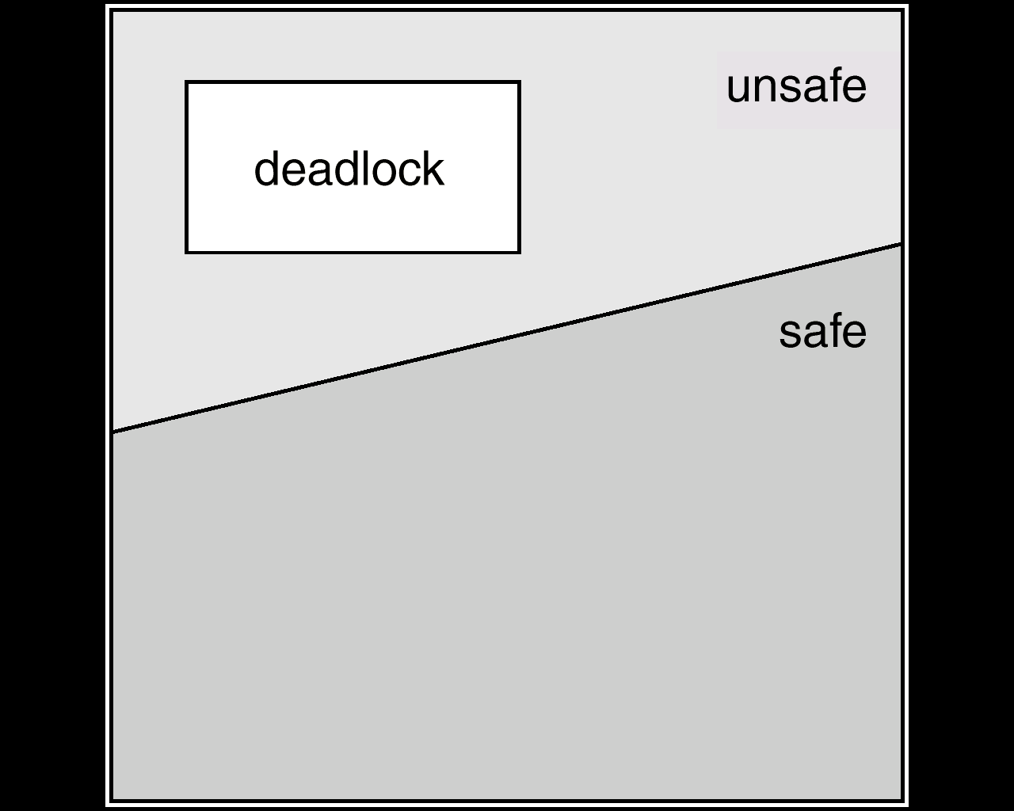
Safe, Unsafe and Deadlock States
If a system is in safe state ⇒ no deadlocks
If a system is in unsafe state ⇒ possibility of deadlock
If a process releases resources much before its completion, then deadlock may not occur
Deadlock Avoidance: Ensure that a system will never enter an unsafe state
Notes:
By definition, if a system is in a safe state, no deadlock.
If the system is in unsafe state, that means, there is no safe sequence for the system. It only means possibility of a deadlock. Because we are considering the worst case in the safe sequence: the resources are released only when the process finishes (the worst case). If the process can release resources before termination. The later processes in the sequence can actually release the resources earlier. So the previous process have more resources to consume. The safe sequence does not consider this case. So, the unsafe state does not mean deadlock. For example, you can change the example in the previous slide: available =0. the system is unsafe. But, if P2 releases the resource earlier, then, all the processes can finish execution.

Slide 32
Banker’s Algorithm
An algorithm to check whether satisfaction of a resource request would lead to an unsafe state
For multiple instances of each resource type
When a process requests a resource it may have to wait (if the allocation leads to unsafe state)
Assumptions
Each process must declare the maximum instances of each resource type that it needs
When a process gets all its resources it must return them in a finite amount of time
Notes:
Now, let’s learn the banker’s algorithm for deadlock avoidance. The algorithm decides whether to meet a resource request, and to avoid the unsafe state. By its name: there are many bankers. They can borrow and lend money to each other. The banker’s algorithm is to make sure that the bankers will not have a deadlock problem.
It can be used for multiple instances of each resource type. If all resource types have a single instance, what algorithm can we use? We can use resource-allocation graph, and see if the resource-allocation graph has a cycle.
We have some assumptions on the process execution. Before execution, each process must declare the maximum number of instances of each resource type that it needs. When a process requests a resource it may have to wait. that is when the allocation leads to unsafe state. When a process gets all its resource, it must return them in a finite amount of time. That means, eventually, the process will finish, and the waiting time of other processes is bounded.

Slide 33
Data Structures for Banker’s Algorithm
n = number of processes; m = number of resource types
Available (vector of length m): If Available [ j ] == k, there are k instances of resource type R_{j} available
Max (n x m matrix): If Max [ i, j ] == k, then process P_{i} may request at most k instances of resource type R_{j}
Allocation (n x m matrix): If Allocation [ i, j ] == k, then P_{i} is currently allocated k instances of R_{j}
Need (n x m matrix): If Need [ i, j ] == k, then P_{i} may need k more instances of R_{j} to complete its task
Need [ i, j ] = Max [ i, j ] – Allocation [ i, j ]
Notes:
Before we introduce the banker’s algorithm, we define the data structures it uses.

Slide 34
Banker’s Algorithm Part 1: Safety Algorithm
Let Work and Finish be vectors of length m and n, respectively; initially
Work = Available
Finish [ i ] = false for i = 1,2, …, n
Find an i such that (a)Finish [i] == false and (b)Need [ i, * ] ≤ Work
If no such i exists, go to step 4
Work = Work + Allocation [ i, * ]; Finish[i] = true
Go to step 2
If Finish [i] == true for all i, then the system is in a safe state
Otherwise the system is in a unsafe state
What if multiple answers?
Work= Available + resources held by all P_{j} (Finish [ j ] = true)
Notes:
Let’s first introduce safety algorithm. The algorithm determines whether the current system is in a safe state or not. If the system is in a safe state, we will find a safe sequence for the system.
In the first step, we define two vectors work and finish to denote the current system state. Work represents the available resources during the execution of the algorithm. We will update it in Step 3. Finish denotes whether a process can be finished. If Finish[i] is true, this means Pi can finish. It is also updated in Step 3.
What if multiple answers? Any one can be chosen. If we go to step 3 and check step 2 again, those processes still satisfy the condition.

Slide 35
Example of Safety Algorithm
5 processes: P₀ through P₄
3 resource types: A (10 instances), B (5 instances) and C (7 instances)
Snapshot at time T₀: Allocation Max Available
A B C A B C A B C
P₀ 0 1 0 7 5 3 3 3 2
P₁ 2 0 0 3 2 2
P₂ 3 0 2 9 0 2
P₃ 2 1 1 2 2 2
P₄ 0 0 2 4 3 3
Notes:
Now, let’ s look at one example. There are five processes, P0 to P4. There are 3 resource types: A with 10 instances, B with 5 instances, and C with 7 instances.
The system state at time T0 is as follows.
Allocation
Max
Available
For example: P0 is allocated with 1 instance of B, and P0 may request 7 instances of A, and 5 instances of B, and 3 instances of C at most.

Slide 36
Example of Safety Algorithm (Cont.)
Then the matrix Need is defined to be Max – Allocation
Allocation Max Need Available
A B C A B C A B C A B C
P₀ 0 1 0 7 5 3 3 3 2
P₁ 2 0 0 3 2 2
P₂ 3 0 2 9 0 2
P₃ 2 1 1 2 2 2
P₄ 0 0 2 4 3 3
7 4 3
1 2 2
6 0 0
0 1 1
4 3 1
Notes:
So, now, let’s calculate Need. By definition, Need=Max- Allocation.

Slide 37
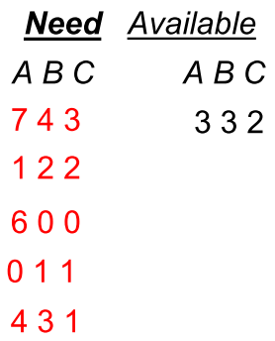
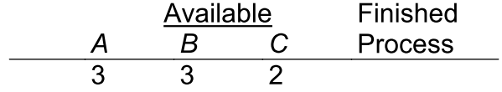
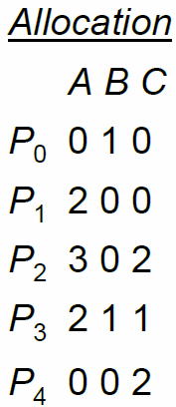





Example of Safety Algorithm (Cont.)
The working is as follows:
Work
P₀
P₁
P₂
P₃
P₄
The system is safe
(sequence <P₁, P₃, P₄, P₂, P₀>)
Notes:
Is there any other completion sequence? As long as you can find a completion sequence for the process, we can say the system is safe.

Slide 38
Banker’s Part 2: Resource-Request Algorithm
Request_{i} = Request vector for process P_{i}
If Request_{i} [ j ] == k then process P_{i} wants k instances of resource type R_{j}
If Request_{i} ≤ Need_{i}, go to step 2
Otherwise, raise error condition, since process has exceeded its maximum claim
If Request_{i} ≤ Available, go to step 3
Otherwise P_{i} must wait, since resources are not available
V1<=V2 ≣ V1[j]<=V2[j], for all j
The i^{th} row of the matrix
Notes:
We now describe the algorithm for resource-request algorithm for a process Pi. We decide whether to grant the resource to the process or let the process wait.
The resource request by the process Pi is represented in a vector Request. If Request [j] == k then process P_{i} wants k instances of resource type R_{j.}

Slide 39
Resource-Request Algorithm (Cont.)
Pretend to allocate requested resources to P_{i} by modifying the state as follows:
Available = Available – Request_{i};
Allocation_{i} = Allocation_{i} + Request_{i};
Need_{i} = Need_{i} – Request_{i};
Run the safety algorithm
Safe ⇒ the resources are allocated to P_{i}
Unsafe ⇒ P_{i} must wait, and the old resource-allocation state is restored

Slide 40
Example of Resource-Request Algorithm
Suppose P₁ requests (1, 0, 2) resources
Step1: Check Request₁ ≤ Need_{1,} (1,0,2) ≤ (1,2,2) ⇒ true
Step2: Check that Request₁ ≤ Available, i.e. (1,0,2) ≤ (3,3,2) ⇒ true
Steps 3 & 4:
Allocation Max Need Available
A B C A B C A B C A B C
P₀ 0 1 0 7 5 3 7 4 3 3 3 2
P₁ 2 0 0 3 2 2 1 2 2
P₂ 3 0 2 9 0 2 6 0 0
P₃ 2 1 1 2 2 2 0 1 1
P₄ 0 0 2 4 3 3 4 3 1
Step 3: Pretend to allocate requested resources
2 3 0
3 0 2
0 2 0
Step 4: Executing safety algorithm shows that sequence <P₁, P₃, P₄, P₀, P₂> is safe
Notes:
In step 3, we pretend to allocate the requested resources.
What are the parameters that we need to change?
Do we need to change Max? no.

Slide 41
Example of Resource-Request Algorithm
Can a further request for (1,0,2) by P₁ be granted?
Step 1: Check if Request₁ ≤ Need_{1,} (1,0,2) ≤ (0,2,0) ⇒ false
Can a further request for (0,2,0) by P₀ be granted?
Step 1: Check if Request₀ ≤ Need_{0,} (0,2,0) ≤ (7,4,3) ⇒ true
Step 2: Check if Request₀ ≤ Available, (0,2,0) ≤ (2,3,0) ⇒ true
Allocation Need Available
A B C A B C A B C
P₀ 0 1 0 7 4 3 2 3 0
P₁ 3 0 2 0 2 0
P₂ 3 0 2 6 0 0
P₃ 2 1 1 0 1 1
P₄ 0 0 2 4 3 1
How about a request for (2,3,0) by P₄?
0 3 0
7 2 3
2 1 0
We cannot find Need_{i} < Available
→ Restore the state
Notes:
Consider another case: Can further request for (0,2,0) by P₀ be granted?
We can actually find that step 1 and step 2 are true. Thus, we pretend to give the resource to P0. Thus, we update the system state by modifying Allocation0, Need0 and Available0.
Then, in step 4, we run the safety algorithm. However, in step 2 of the safety algorithm, we cannot find any process with Needi<=Available. Thus, the system is unsafe.
What should we do? We should restore the old state.
How about a request for (2,3,0) by P₄ ?
This is for your homework.

Slide 42
Part 5: Deadlocks and Starvation
Deadlock Problem
System Model
Deadlock Conditions
Deadlock Prevention
Deadlock Avoidance
Deadlock Detection

Slide 43
Deadlock Detection
Allow system to enter deadlock state
Then invoke detection algorithms
For single instance of each resource type (in textbook based on identifying cycle in resource-allocation graph)
For multiple instances of each resource type (next few slides)
Then invoke recovery algorithm (in textbook)
This slide and the later slides in this chapter are not examinable
Notes:
The basic idea of deadlock detection is to allow system to enter deadlock state, then invoke detection algorithm periodically. If there is a deadlock, we invoke the recovery algorithm.
The deadlock detection algorithm is actually similar to deadlock avoidance algorithm. If you are interested in them, you can refer to textbooks or just go through them in slides. They are not examinable.

Slide 44
Multiple Instances of Each Resource Type
Available: A vector of length m indicates the number of available resource types
Allocation: An n x m matrix defines the number of resources of each type currently allocated to each process
Request: An n x m matrix indicates the current request of each process. If Request [ i, j ] = k, then process P_{i} is requesting k more instances of resource type R_{j}

Slide 45
Detection Algorithm
Let Work and Finish be vectors of length m and n, respectively; initially
Work = Available
For i = 1,2, …, n, if Allocation_{i} != 0, then Finish[ i ] = false, else Finish[i] = true
Find an i such that (a)Finish [i] == false and (b)Request [ i, * ] ≤ Work
If no such i exists, go to step 4
Work = Work + Allocation [ i, * ]; Finish[i] = true
Go to step 2
If Finish [i] == false for some i, then system (process P_{i}) is deadlocked
Notes:
Let’s first introduce safety algorithm. The algorithm determines whether the current system is in a safe state or not. If the system is in a safe state, we will find a safe sequence for the system.
In the first step, we define two vectors work and finish to denote the current system state. Work represents the available resources during the execution of the algorithm. We will update it in Step 3. Finish denotes whether a process can be finished. If Finish[i] is true, this means Pi can finish. It is also updated in Step 3.
What if multiple answers? Any one can be chosen. If we go to step 3 and check step 2 again, those processes still satisfy the condition.

Slide 46
Example of Detection Algorithm
Five processes: P₀ through P₄
Three resource types: A (7 instances), B (2 instances), and C (6 instances)
Snapshot at time T₀: Allocation Request Available
A B C A B C A B C
P₀ 0 1 0 0 0 0 0 0 0
P₁ 2 0 0 2 0 2
P₂ 3 0 3 0 0 0
P₃ 2 1 1 1 0 0
P₄ 0 0 2 0 0 2
Sequence <P₀, P₂, P₃, P₁, P₄> results in Finish[i] = true for all i

Slide 47
Example of Detection Algorithm (Cont.)
Suppose P₂ requests an additional instance of type C
Allocation Request Available
A B C A B C A B C
P₀ 0 1 0 0 0 0 0 0 0
P₁ 2 0 0 2 0 2
P₂ 3 0 3 0 0 1
P₃ 2 1 1 1 0 0
P₄ 0 0 2 0 0 2
Work
Finished
A B C
P₀
0 0 0
☹
+
0 1 0
☹
0 1 0
☹
☹

Slide 48
Example of Detection Algorithm (Cont.)
State of system?
Can reclaim resources held by process P₀, but insufficient resources to fulfill other process requests
Deadlock exists, consisting of processes P₁, P₂, P₃, and P₄

Slide 49
Course Overview
OS goals
CPU management
Memory management
Filesystem management
Processes (L2)
Scheduling (L3)
Memory organization (L8)
Virtual memory (L9-10)
Filesystems (L11)
Synchronization (L5-6)
Deadlocks (L7)
I/O & disk (L12)
Special: Real-time OS & virtualization

Slide 50
Putting All Concepts Together

Slide 51
Putting All Concepts Together

Slide 52
Putting All Concepts Together

Slide 53
Advanced Readings
“The Deadlock Problem: An Overview”, By Sreekaanth S. Isloor, T. Anthony Marsland. (pdf in NTULearn)
Other readings
Java Concurrency, http://docs.oracle.com/javase/tutorial/essential/concurrency/index.html
Deadlock, http://en.wikipedia.org/wiki/Deadlock
Notes:
Those are advanced readings, if you want to know more beyond the text book.

